Slide 1

National Telecommunication institute
IC digital design using FPGA
SPI Master/Slave
SUPERVISED BY
ENG. AHMED ALHUSSIENY

Slide 2

Team members
Esther George Fayez Abdo
: SPI Master
Eyad Khalid Mabrouk Noah
: SPI Slave
Radwa Ahmed Abd-Elsatar Ali : Integration & Verification

Slide 3
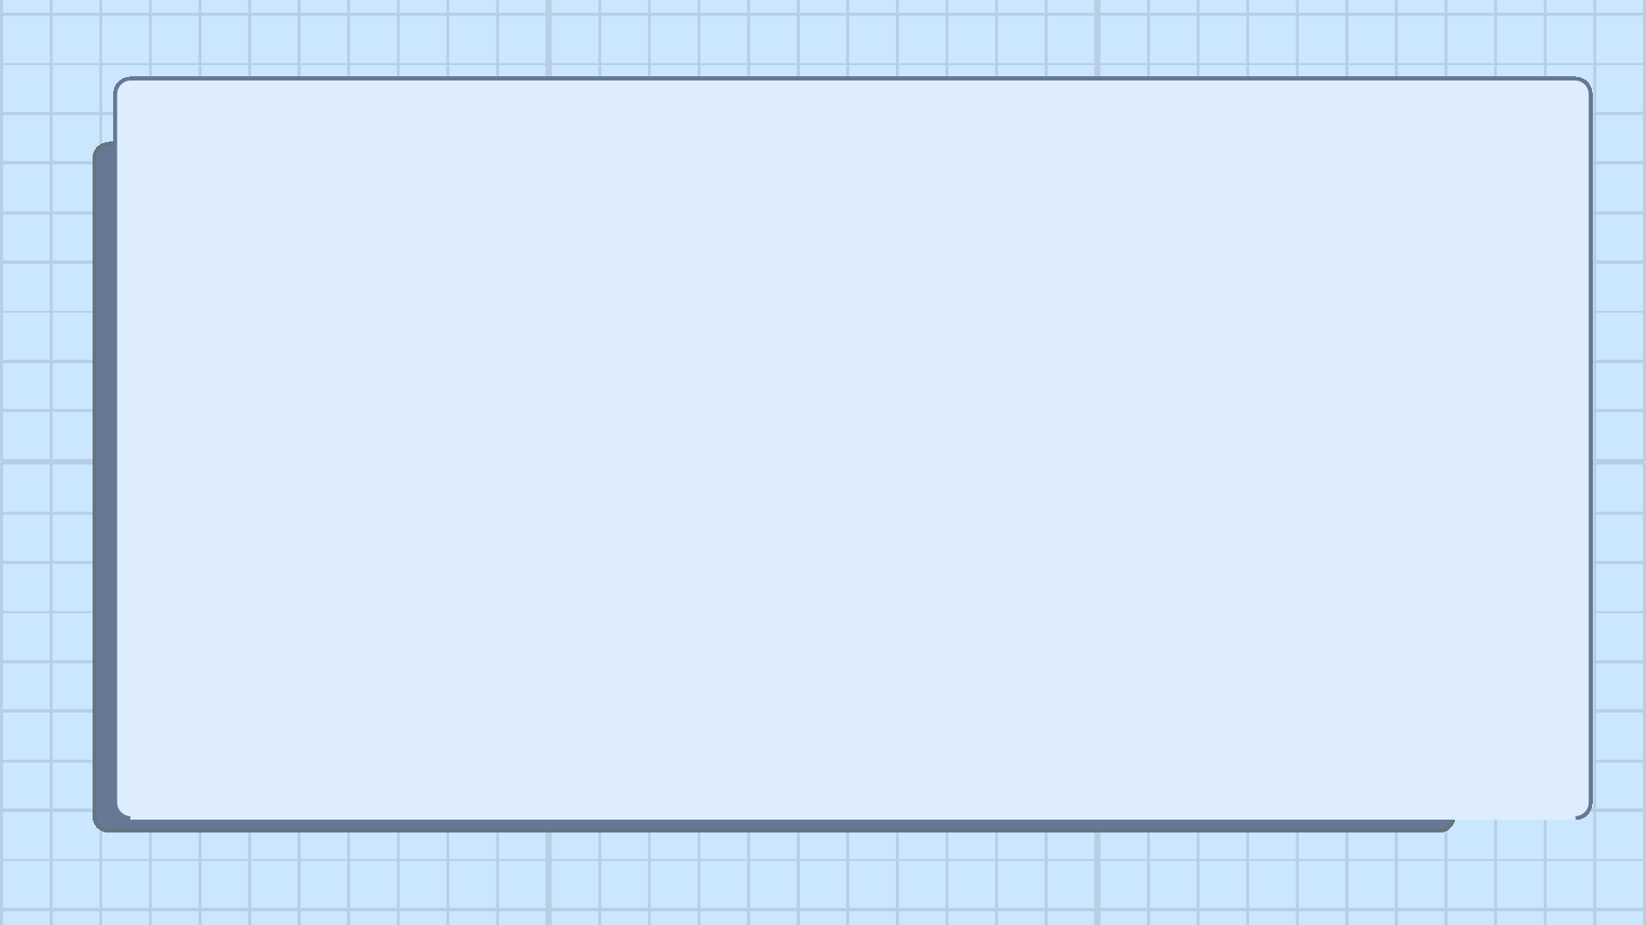
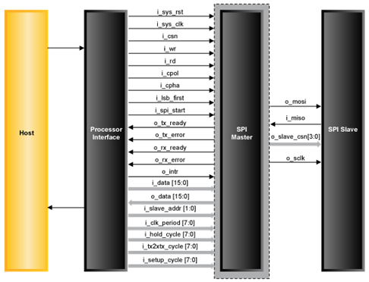
What is SPI?
SPI (Serial Peripheral Interface) is a synchronous serial communication protocol used for high-speed data exchange between digital devices.
Features
Full-duplex communication
Master controls the communication High-speed synchronous protocol Simple hardware interface
Widely used with sensors, memories and ADC/DACs

Slide 4

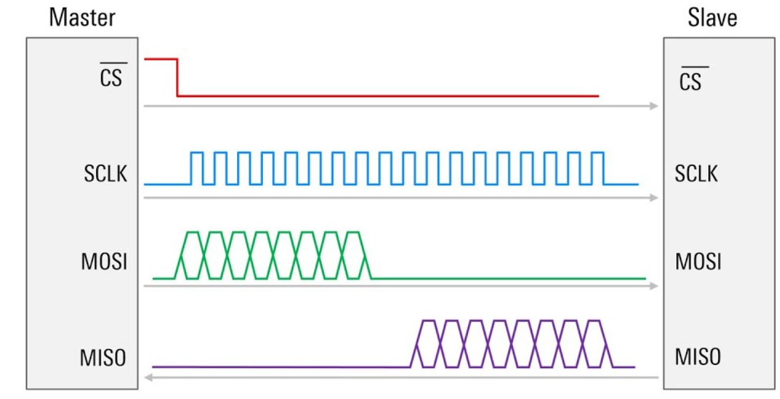
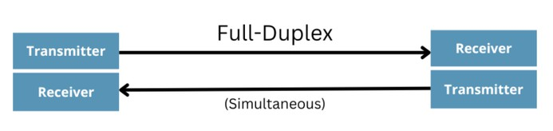
MOSI – Master Out Slave In MISO – Master In Slave Out
SCLK – Serial Clock generated by the master CS – Chip Select (active low)
SPI FRAME

Slide 5
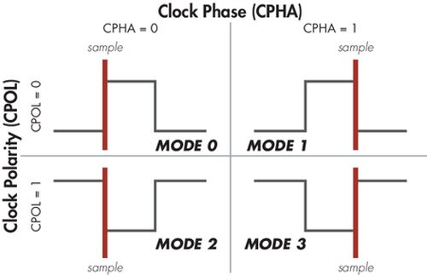
SPI Modes
Our project uses mode 0 but it can be developed to support the other 3 modes

Slide 6
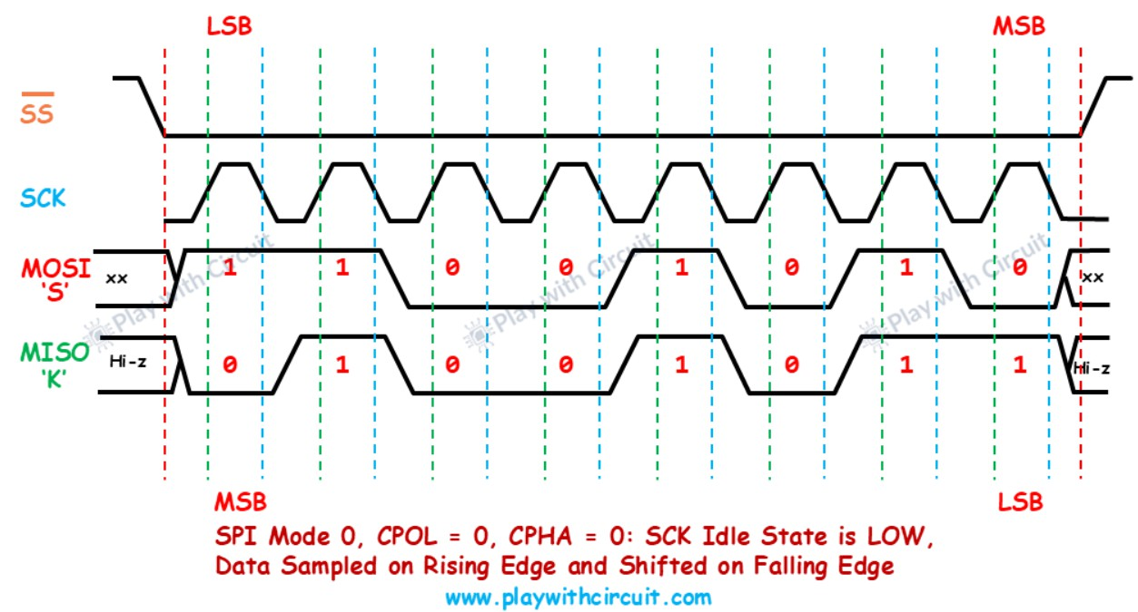
SPI Timing

Slide 7
Master Specifications
Feature | Value
DATA_WIDTH | Parameterized
MODE | Parameterized
CLK_DIV | Parameterized
MSB_FIRST | Parameterized
FSM | 4 States
Synthesizable | Yes
Continuous Assignment | MOSI
Shift Registers | TX and RX
Clock Divider | Yes

Slide 8
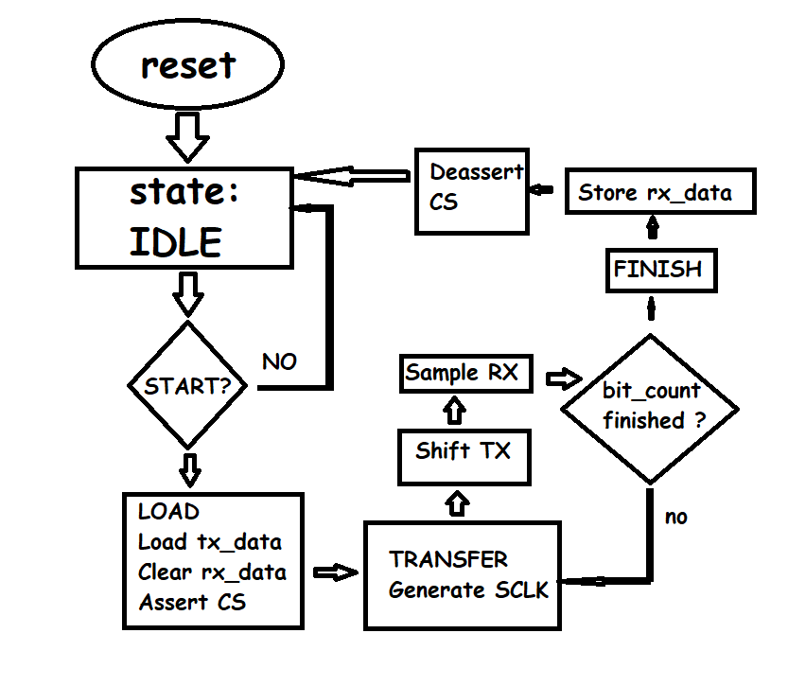
Master Algorithm & FSM
State | Function
IDLE | Wait for start signal
LOAD | Load transmit data
TRANSFER | Shift and receive bits
FINISH | Save received data and end transfer

Slide 9
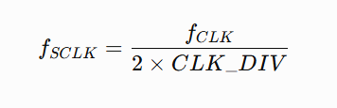
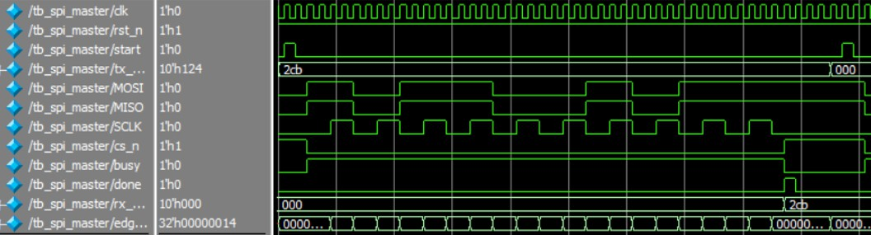
Clock Divider
EXAMPLE
CLK_DIV | SCLK
1 | clk/2
2 | clk/4
4 | clk/8
8 | clk/16

Slide 10
Slave & RAM 1.Block Diagram &Ports 2.RAM Size 3.FSM 4.Algorithm 5.Simulation

Slide 11
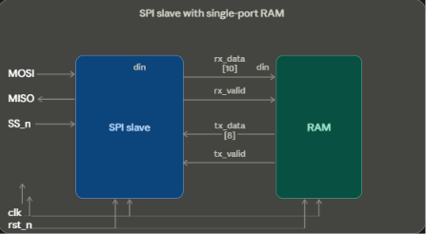
Block Diagram & Ports
Inputs | Outputs
clk | miso
rstn | _
ss_n | _
mosi | _

Slide 12
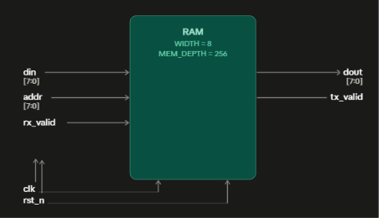
RAM Size Data Width = 8 Memort Depth = 256

Slide 13
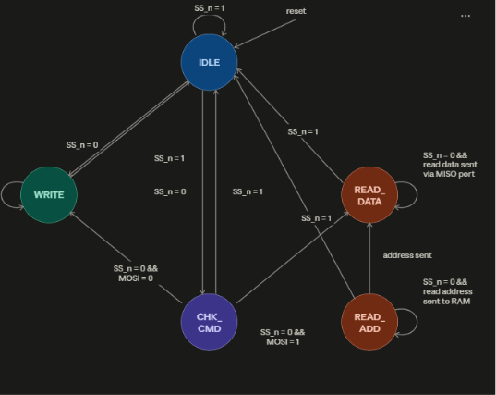
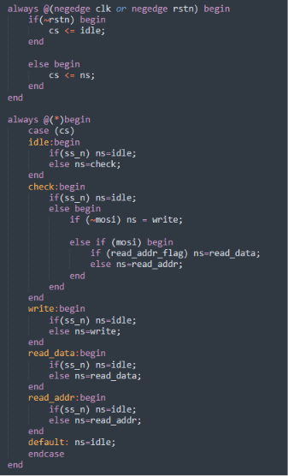
FSM

Slide 14
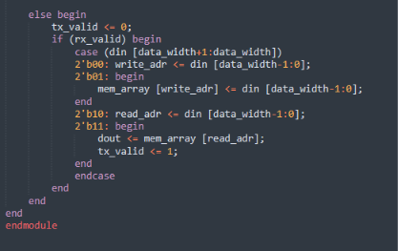
Algorithm write_addr write_data read_addr read_data

Slide 15
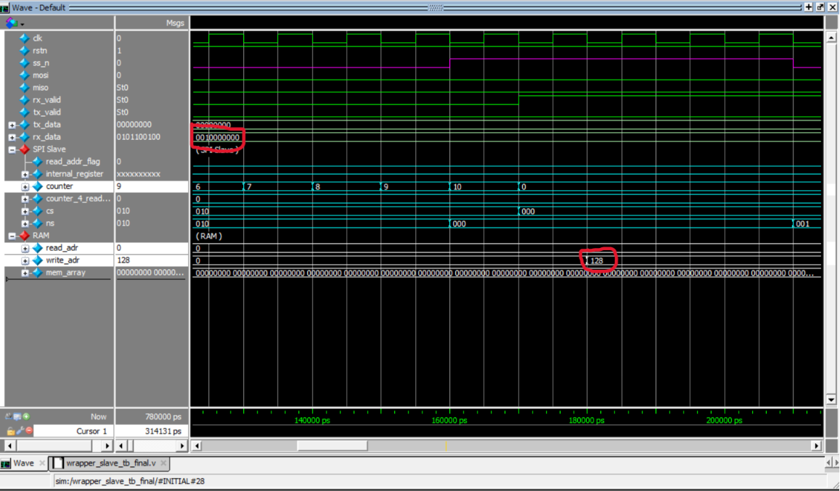
Simulation 1.Write Address

Slide 16
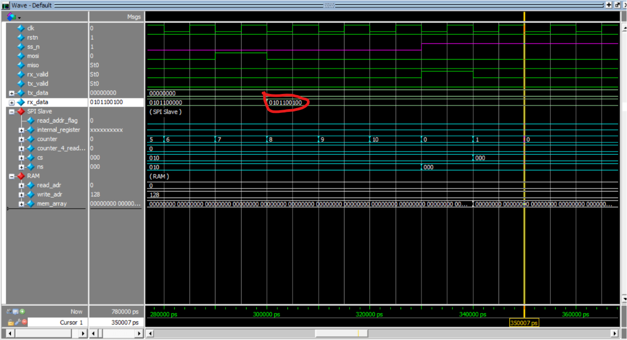
Write Data

Slide 17
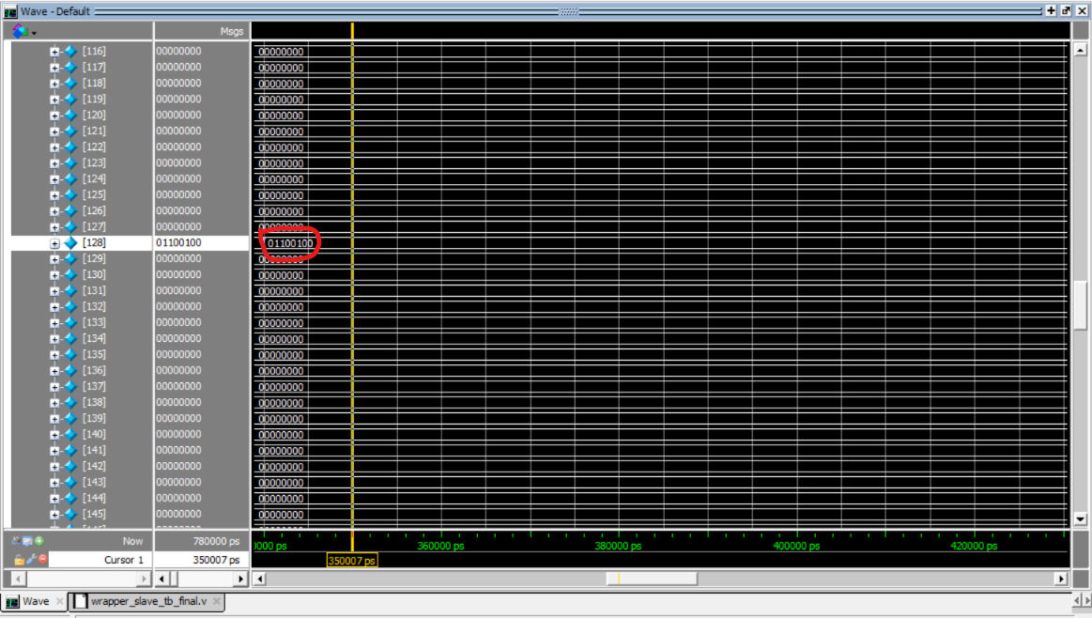
Write Data

Slide 18
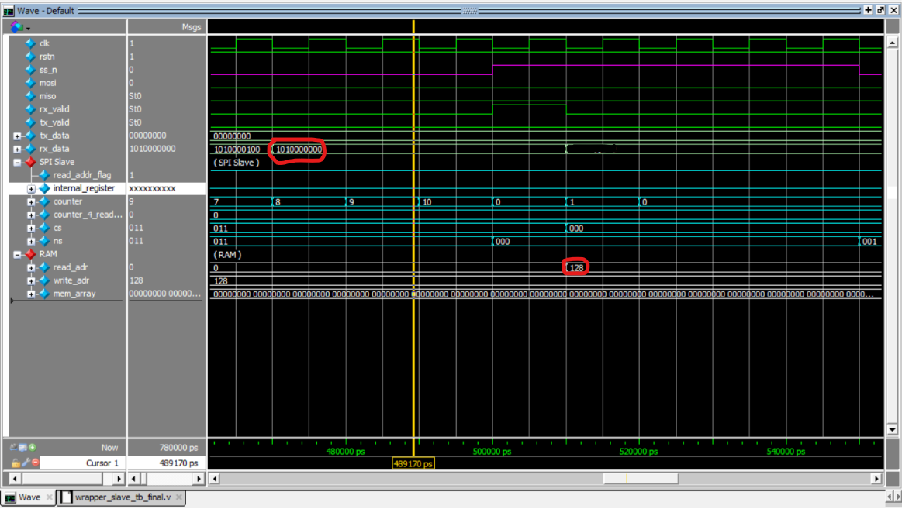
Read Address

Slide 19
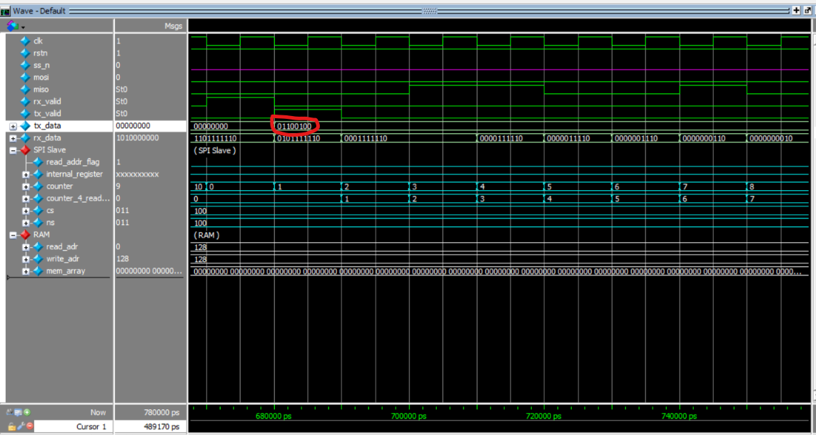
Read Data

Slide 20
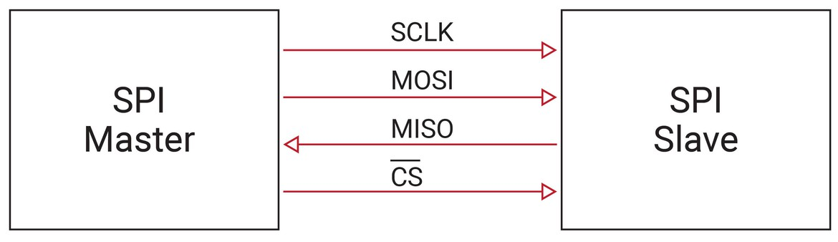
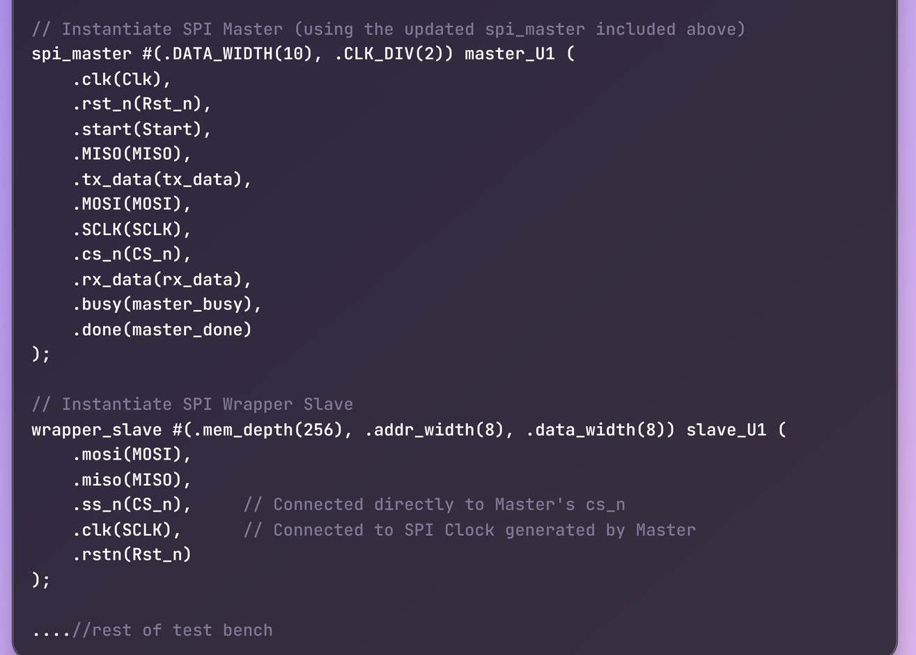
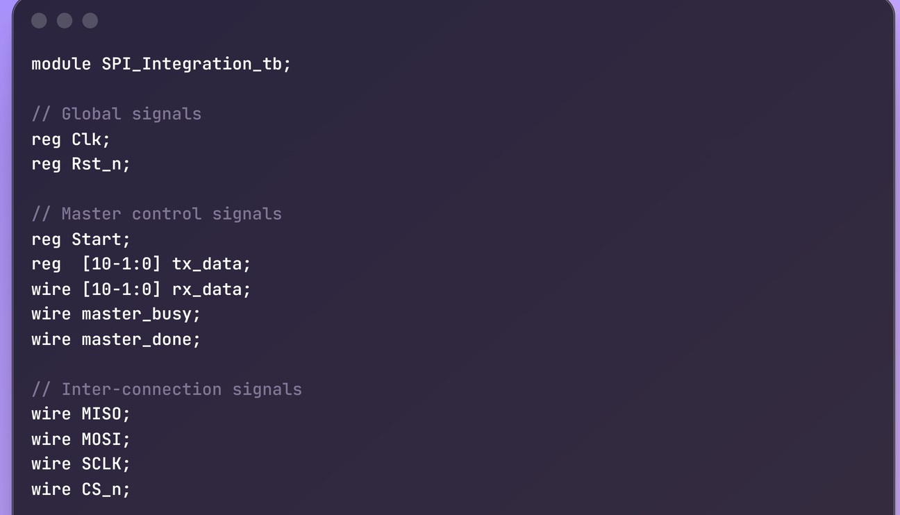
Integration
Check the parameters consistency Check timing consistency (e.g. tuning rx_valid with SCLK)
Monitor din and dout data flow Avoid zeroing of necessary data

Slide 21
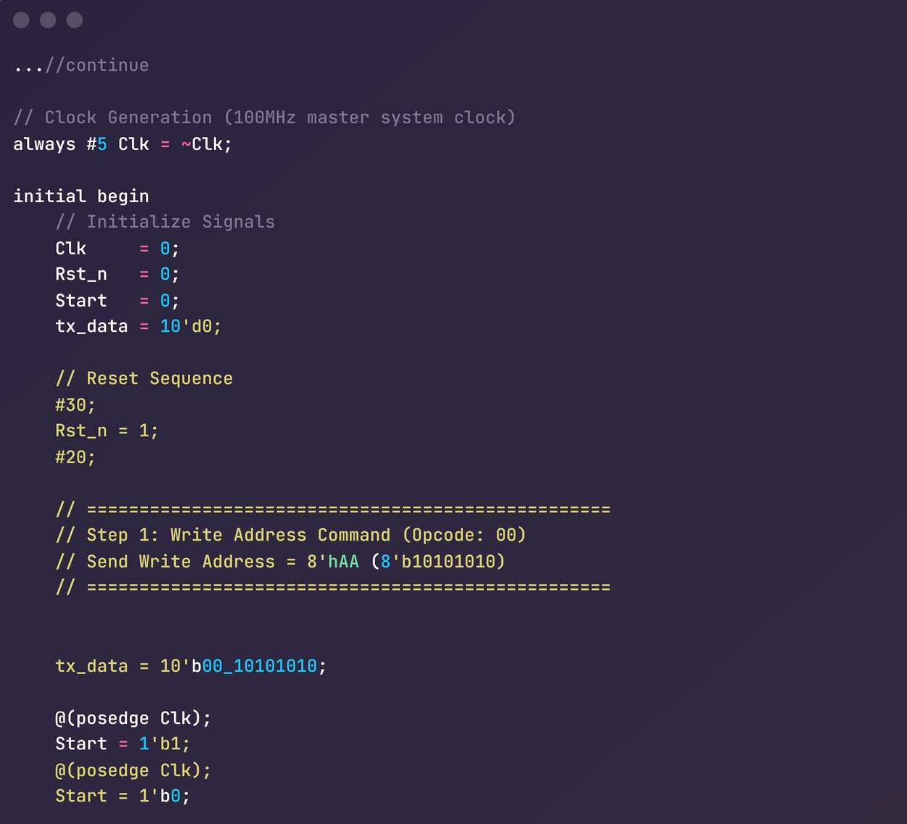
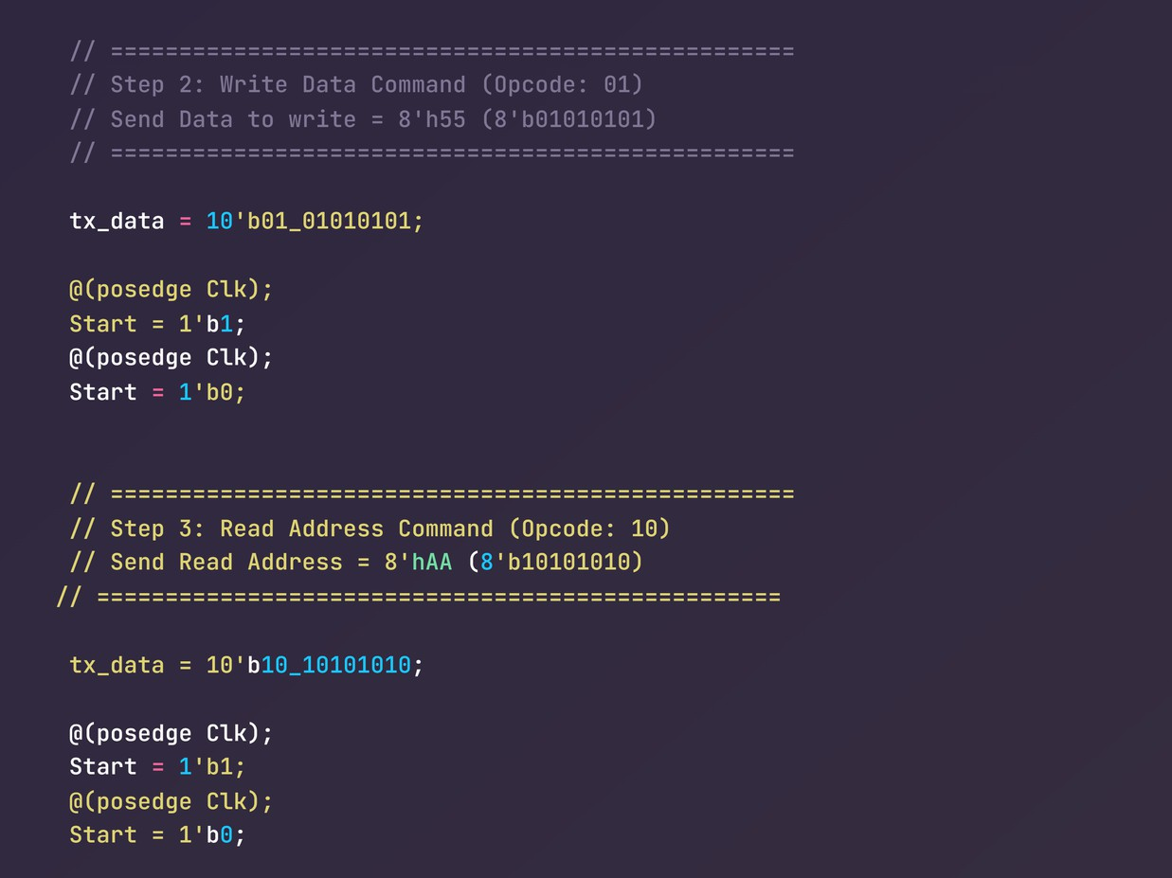
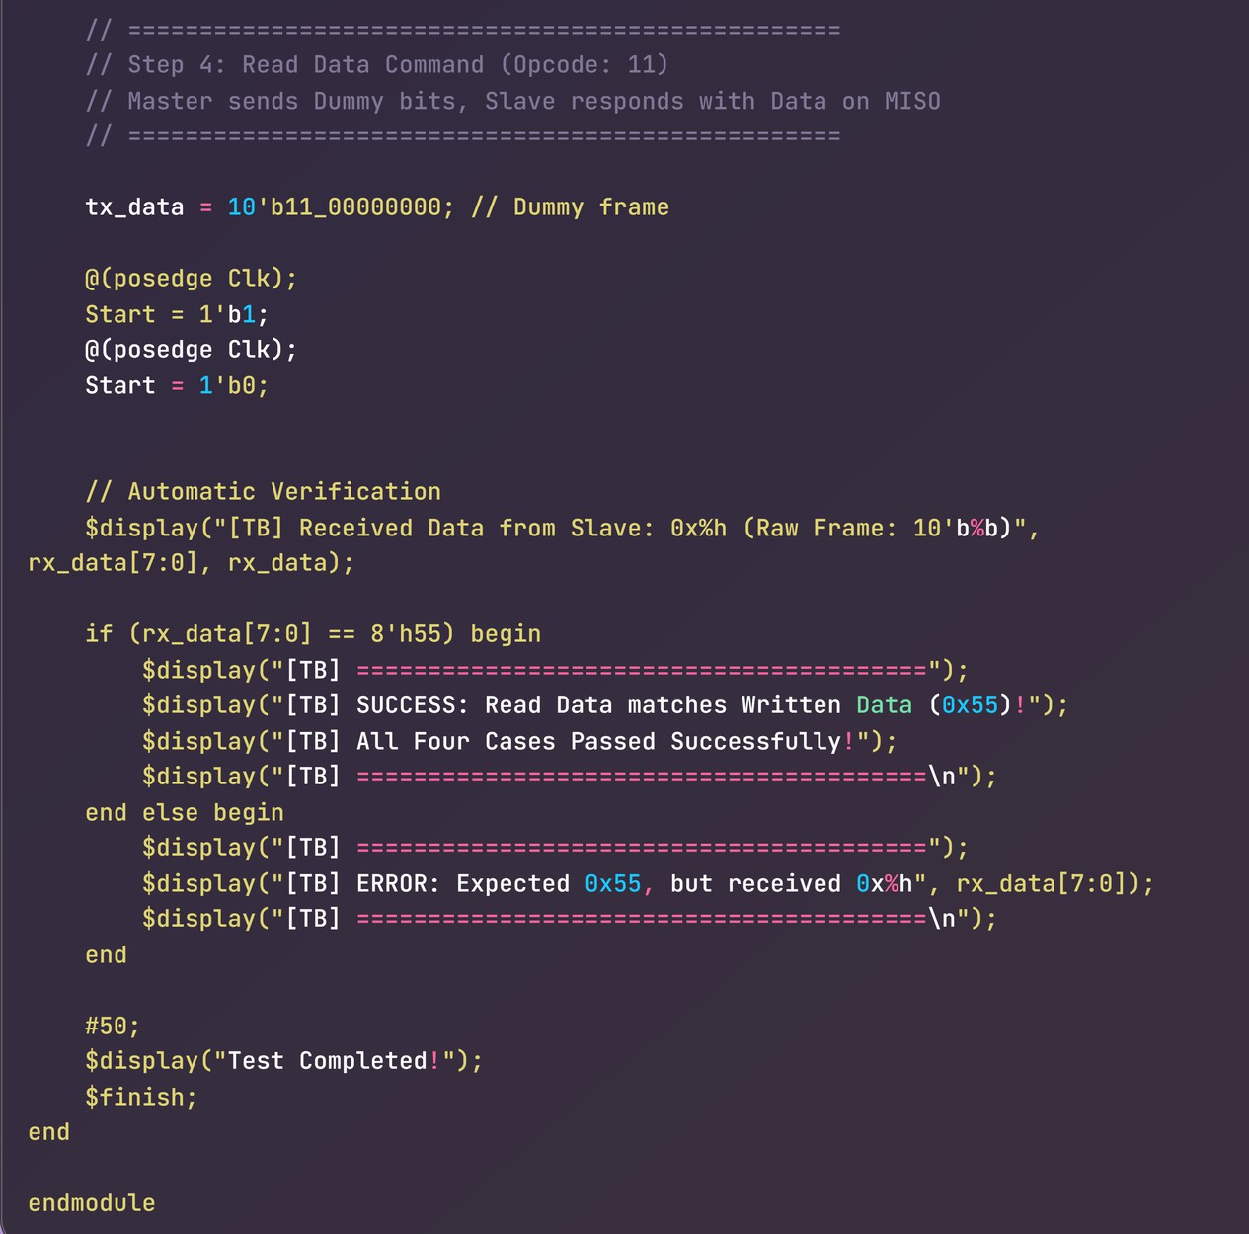
STEP 1: Write Address (0xAA) Loaded into Slave STEP 2: Write Data (0x55) committed to RAM[xAA] STEP 3: Read Address (0xAA) Loaded into Slave STEP 4: Read Data (0x55) captured on MISO line
Verification & Testbench

Slide 22
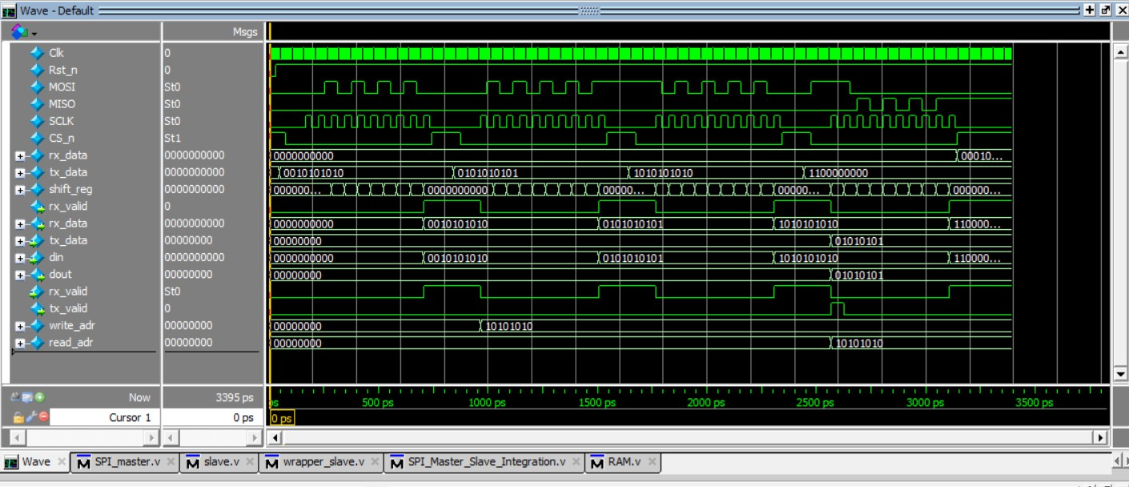
Verification & Testbench

Slide 23
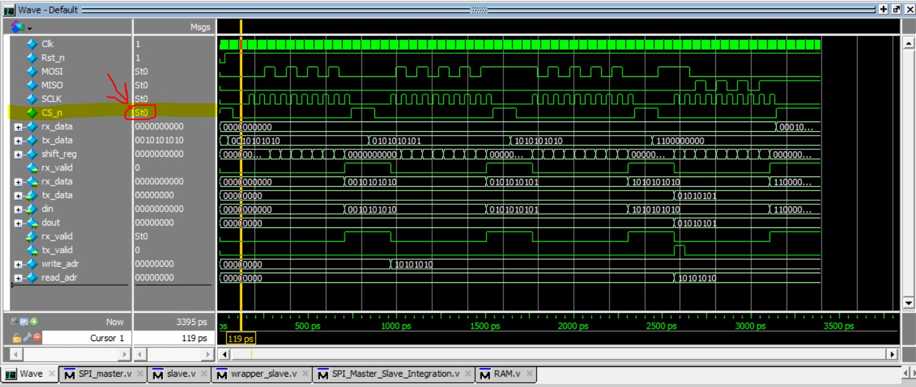
Verification & Testbench

Slide 24
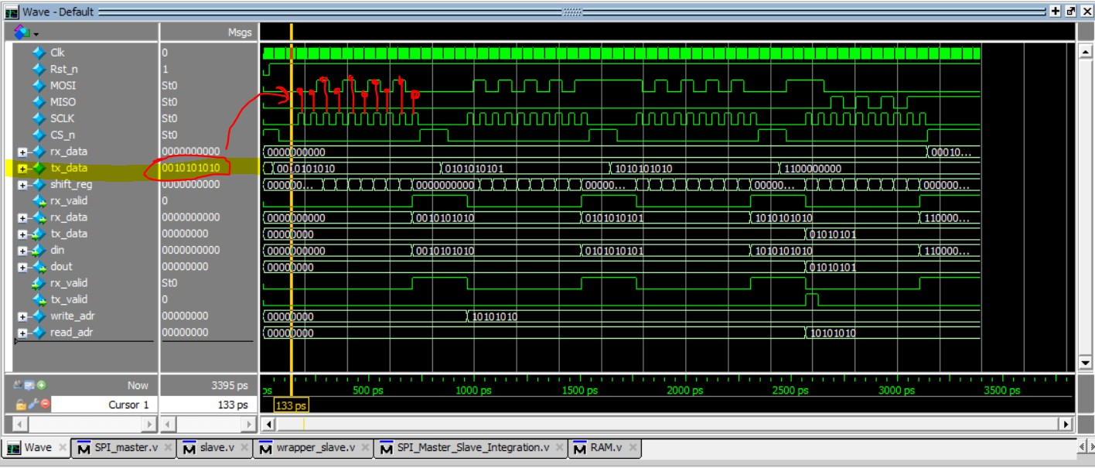
Verification & Testbench

Slide 25
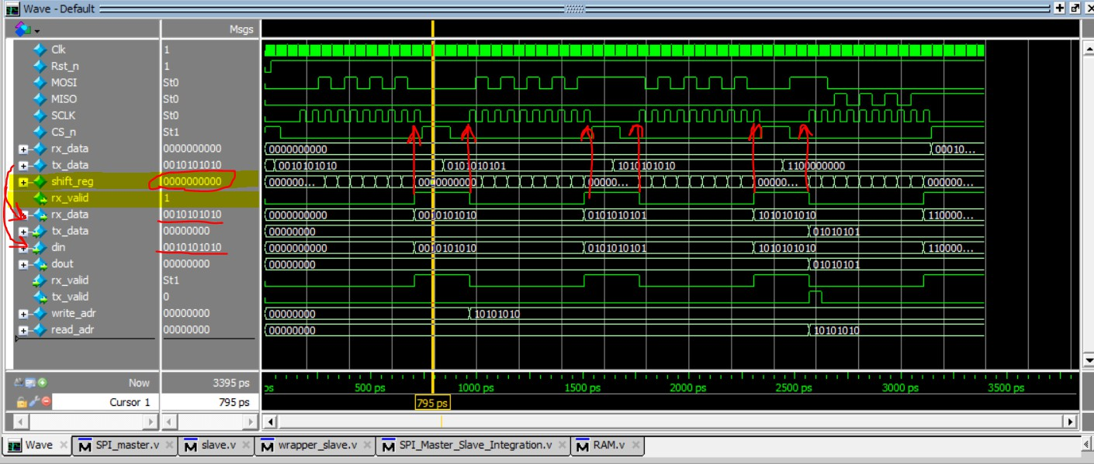
Verification & Testbench

Slide 26
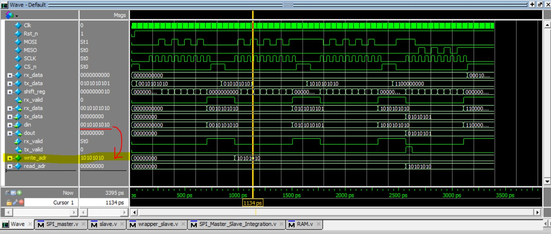
Verification & Testbench

Slide 27
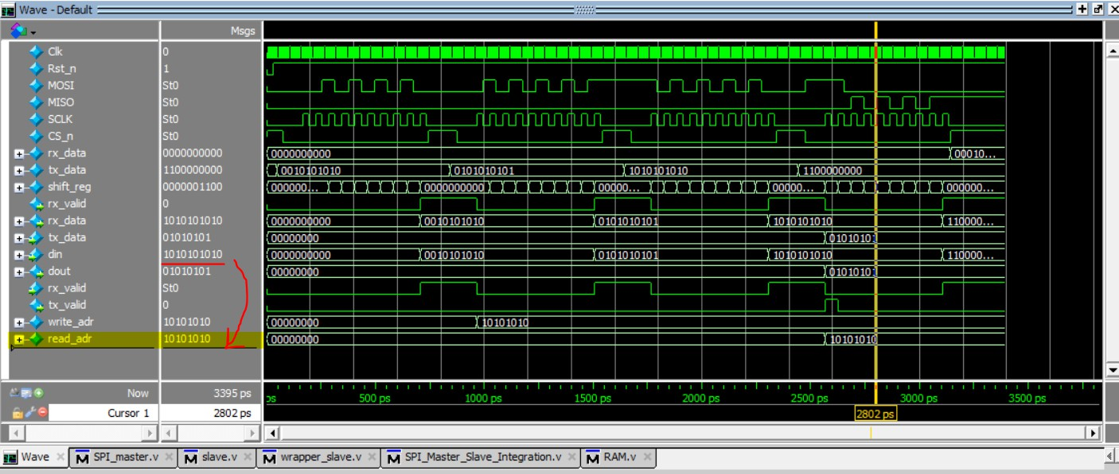
Verification & Testbench

Slide 28
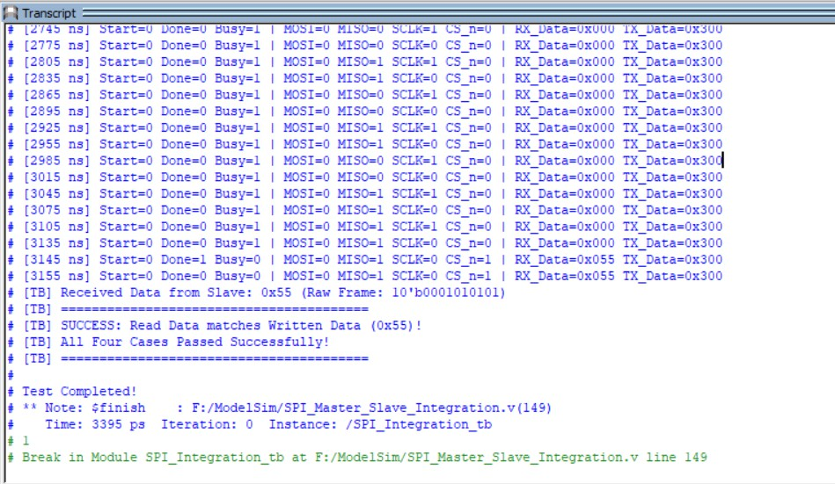
Verification & Testbench

Slide 29
Future improvements
Feature | Benefit
Four SPI Modes | Full compatibility
Multiple Slaves | Larger SPI bus

Slide 30
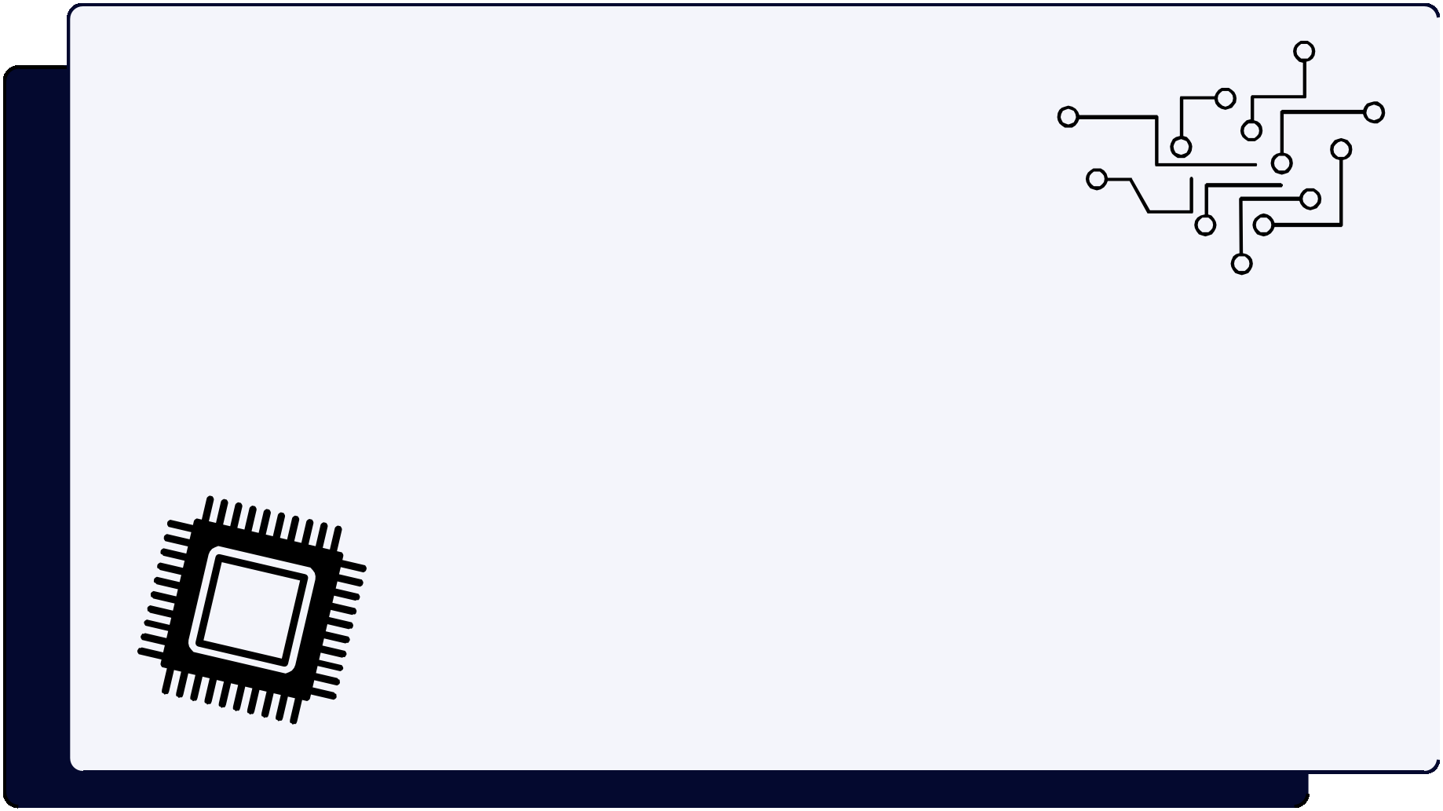
Thank you for listening

